Slide 1
PI 7.3 AEX-Architecture

Slide 2
Introduction to Advanced Adapter Engine Extended (AEX)
AEX Uses
Benefits and Features
Summary

Slide 3
What’s New AEX?
What is the new Advanced Adapter Engine Extended (AEX)?
SAP Net Weaver Process Integration installation alternative.
Fully independent, single-stack solution based on SAP Net Weaver AS Java only– Own integration domain.
Own tools for design, configuration, and operations.
ES Repository, Integration Directory, SLD,NWA, Monitoring.
Powered by Advanced Adapter Engine (AAE) introduced in 7.1 (but with more capabilities).
Not to be confused with a non-central AAE.
Additional mediation and connectivity features to allow for major scenario shifts to AEX Available starting from SAP Net Weaver PI 7.3.

Slide 4
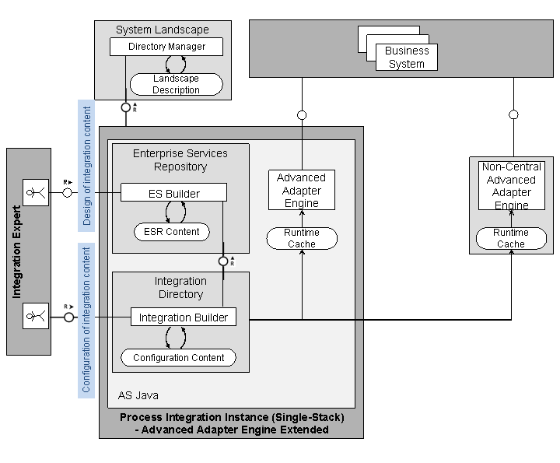
AEX Introduction
Advanced Adapter Engine Extended (AEX) provides the connectivity capabilities of the AAE as well as the design and configuration tools to set up scenarios based on the AAE.
AEX uses the Advanced Adapter Engine as runtime engine.
To process messages, the AAE uses information from the Integration Directory. This information is made available to the AAE via a runtime cache.
The following figure shows the main components of the AEX
Design Time-Enterprise Services Repository
Configuration Time -Integration Directory
SLD - System Landscape Directory
AEX Architecture

Slide 5
Capabilities
AEX supports the mediation capabilities of the AAE. In particular, you can use the following adapters:
RFC Adapter
SAP Business Connector Adapter
File/FTP Adapter
JDBC Adapter
JMS Adapter
SOAP Adapter
Marketplace Adapter
Mail Adapter
RNIF Adapter
CDIX Adapter
IDoc Adapter (Advanced Adapter Engine) (adapter type IDOC_AAE)
HTTP Adapter (Advanced Adapter Engine) (adapter type HTTP_AAE)

Slide 6
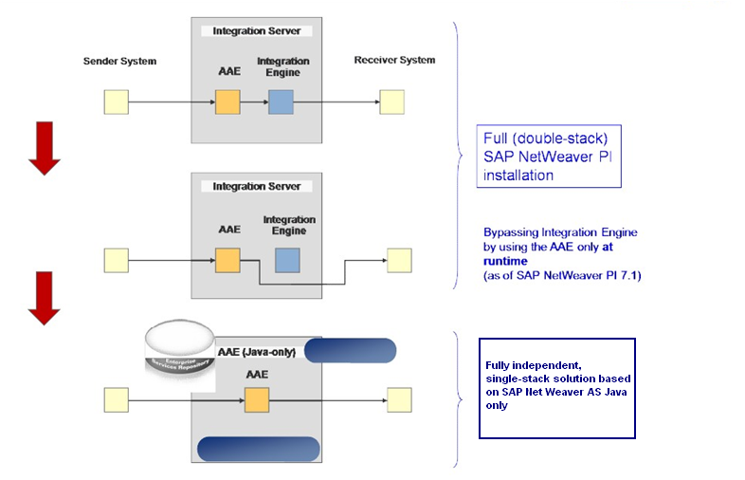
Single stack ESB capabilities via AAE Advanced Adapter Engine Extended

Slide 7
AEX Standalone
Standalone illustrated figure
Using AEX standalone
Using AEX as “lightweight” and low-cost integration middleware
This installation option for AEX is technically based only on the AS Java for scenarios that do not contain any integration processes (cross-component BPM).
Using AEX as test environment
AEX installation provides not only a runtime engine AAE but also the ES Repository and the Integration Directory.
It provides a complete and consistent toolset to set up, configure and test integration scenarios in your landscape.
AEX provides only a restricted functional range as compared with SAP Net Weaver PI complete installation. In particular, you cannot test integration processes (ccBPM) with this setup.
Using AEX as fail-over system
It gives option for transport complete integration scenarios (integration content from the ES Repository) as well as the configuration content (Integration Directory) from a productive landscape to a “fail-over landscape” based on AEX.
This transport option is restricted to those Integration Directory objects that are supported by AEX, for example integrated configurations.

Slide 8
Using AEX with an additional SAP Net Weaver PI
AEX with an Additional SAP PI Cases
AEX with Additional SAP PI illustrated figure
Separating network zones
Landscape setup can be done based on an SAP Net Weaver PI standard installation for your security-critical scenarios.
AEX installation can be added in demilitarized zone (DMZ) that is used for the external communication.
Between the AEX in the DMZ and the “PI standard system”, one can easily configure a change of the transport protocol in order to provide maximum security.
Separating landscapes for different regions of an enterprise
Landscapes can be used based on AEX as cost-saving integration solution for the regional business processes and a PI standard installation for the central processes of an enterprise.
Be carefully with implications with the content of the individual ES Repositories (installed with the AEX on the one and with the standard PI system on the other hand) is not aligned automatically so that suitable transport scenarios have to be planned.

Slide 9
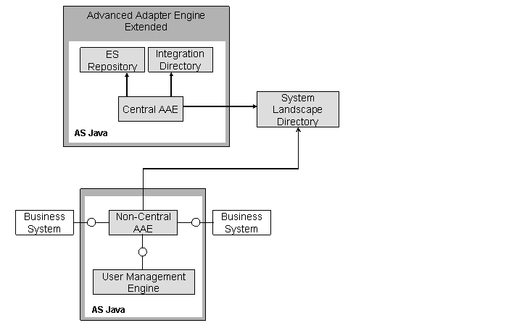
Using a Non-Central AAE as Part of an AEX Installation
Provides option to install a non-central Advanced Adapter Engine separately on a system with a different SAP system ID (SID) than the central AAE.
At runtime, the non-central AAE works independent from the central one.
The design and configuration environment resides on the server of the central AAE. Both central and non-central AAE register themselves at the same SLD.
With regard to user management, the non-central AAE has local User Management Engine.
Following are the characteristics of the usage of a non-central AAE in an AEX installation:
The non-central AAE is configured using the Java Service Properties in SAP Net Weaver Administrator.
Scenarios involving Integration Engine in the communication cannot be setup.
The following figure illustrates the set up.

Slide 10
Advanced Adapter Engine Extended Benefits
Main Benefits
Reduction in overall TCO with single-stack
Faster installation (1 hr)*
Less hardware (½ hardware requirement)*
Fast restart (90 secs)*
Hardware dependent
Drastically reduced resource consumption (scenarios can speed up to a factor 10)
Conversely, need only 10% of resources for comparable performance, sizing cut down by factors
Up to 60% less energy consumption
Monitoring simplification with one dedicated toolset and one stack .
All end-to-end monitoring and configuration information
One database scheme

Slide 11
AEX Features in Detail Closing the Gap
Close gaps to enable major scenario shifts from dual-stack PI to AAE
Further support of adapters
IDOC adapter in AAE
HTTP adapter in AAE
Interface and mapping split on AAE
User defined message search (replacing TREX)
Optional message versions (on error / before routing / after mapping / validation …)
XML Validation redesign (ESR schema based)
Still to come:
Integration processes
WS-RM support (WS Adapter)
IDoc adapter not yet complete

Slide 12
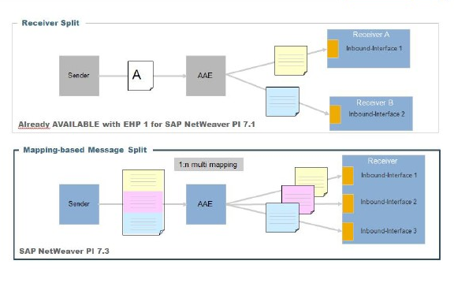
AEX Features in Detail Multi-Mapping Based Message Split on AAE
Benefits
Accelerated and resource friendly message processing for complex scenarios
Ability to leverage the high performance capabilities of the AAE for message based split Scenario
Functional Insight
Ability to split an outbound message in parts and send to multiple receivers via a single 1:n mapping
Possibility to split the message using complex payload conditions.
Messages are sent via the same AAE.

Slide 13
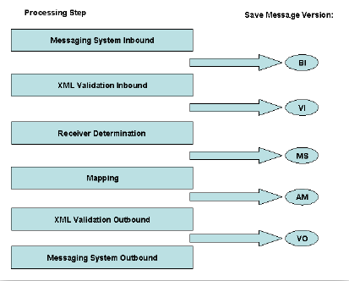
Optional Message Versions on the Advanced Adapter Engine
Benefits
More detailed monitoring of message processing on the Advanced Adapter Engine
Assurance of better compliance with legal requirements
Improved accountability of the message transformations during message processing on the Service Bus
Functional Insight
In SAP NetWeaver Administrator Configuration Management ->Infrastructure --->Java System Properties, XPI Adapter: XI
Set xiadapter.stage.confparameter to:
0 No Storage
1 Store on error
2 Store and continue
3 Store and return

Slide 14
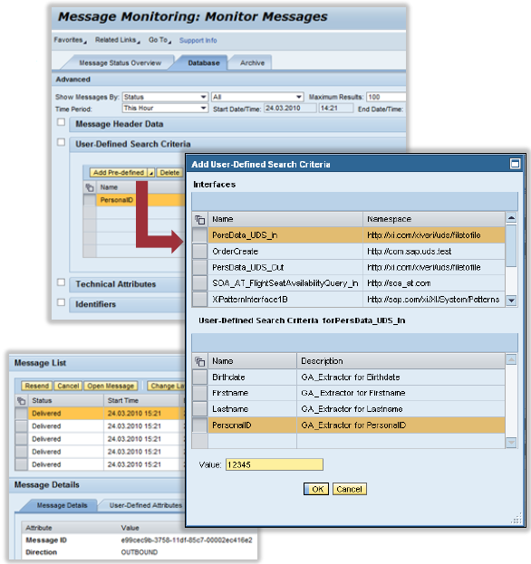
User-Defined Message Search on AAE
Benefits
Indexed message search out-of-the-box (no need for TREX)
Functional Insight
Pre-defined payload fields extracted during message processing (Xpath expression)
Fields (name/value) are stored into an index table
Search integrated into local AAE (and IE) message monitors
Index is archived together with message
Payload fields and adapter-specific headers available for indexing
Monitoring search for multiple attributes possible

Slide 15
AEX Features in Detail IDoc Adapter in Advanced Adapter Engine
Adapter Characteristics and (some) Differences to ABAP based Adapter
Enables IDoc connectivity for local processing on AAE
Integrated with channel monitoring for administration (unavailable for ABAP-based adapters)
Specific IDoc Monitor for monitoring IDoc message traffic and metadata processed on AAE
Supports sender IDoc Packaging and IDoc flat file modules introduced in EHP1 for SAP
Net Weaver PI 7.1
Communication with JCO-based IDoc senders and receivers is not supported
QoS: EO and EOIO (but NOT using qRFC, function module IDOC_INBOUND_IN_QUEUE is
not supported on AS Java)
Communication with systems with multiple code pages is no supported
(MDMP = Multi Display/Multi Processing)
Security with basic authentication but no transport level security

Slide 16
AEX Features in Detail Java HTTP Adapter – Overview
Supports all major functions of ABAP HTTP adapter
HTTP POST
Quality of Service (BE, EO, and EOIO)
Secure communication via SSL
Adapter-specific message attributes (Dynamic Configuration)
Additional support
HTTP 1.1
HTTP GET
Multipart documents
Form submission
Attachments
System Acknowledgement (positive & negative)

Slide 17
AEX Features in Detail New Adapter Features
New Adapter Features
Large (binary) file-to-file transfer
Configurable JDBC message size limits
Time-out configuration per communication channel
Publish and subscribe messaging for JMS Topics

Slide 18
Summary
AEX Installation is the Improve PI performance
AEX supports the mediation capabilities of the AAE.
AEX can be installed standalone or combination with an additional
SAP Net Weaver PI landscape
AEX has Reduced in overall TCO with single-stack, Faster installation (1 hr)*, Less hardware (½ hardware requirement)*,Fast restart (90 secs)*,Hardware dependent

